Slide 1
British Airways
Customer ratings analysis and insights
2023-5-22

Slide 2
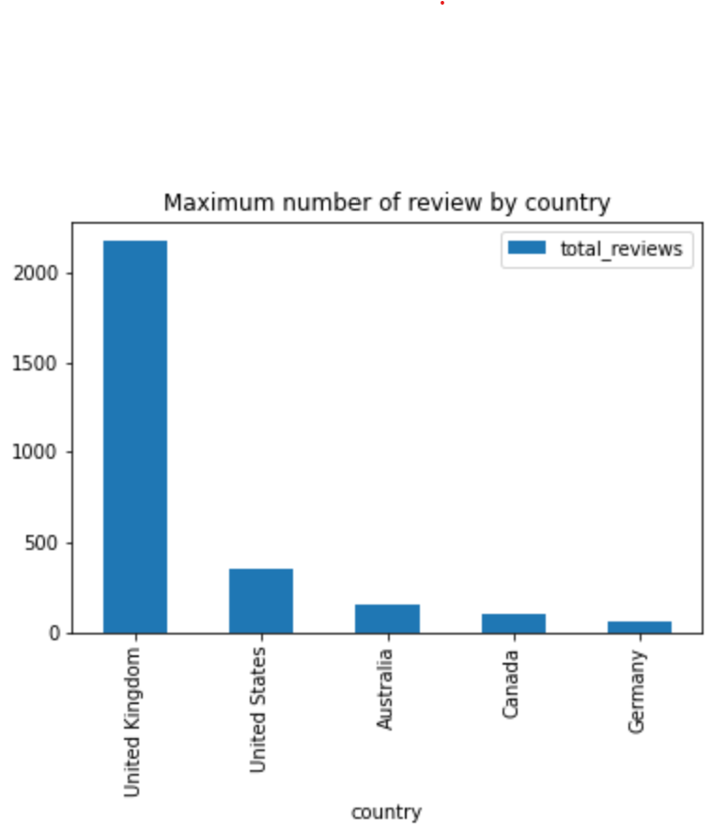
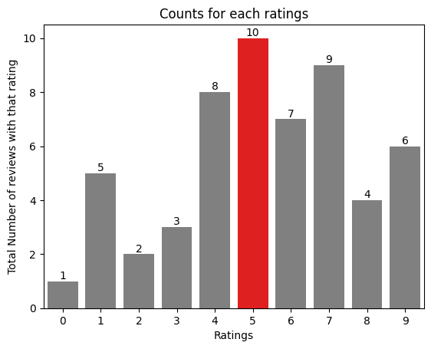
Key metrics
Reviews from 69 Countries
Average Overall Rating
4.73 /10
3548 Total reviews
collected
Based on customer ratings, here is a summary of their feedback:
For ratings 7-10, customers were generally happy with comfortable seats, good inflight entertainment, and decent food quality.
For ratings 4-6, customers mentioned issues with small entertainment screens, long passport check queues, and a negative experience in business class.
For ratings 1-3, customers expressed dissatisfaction with congested middle seats and small screens, while they still appreciated the seats and food.
This analysis provides insights into the aspects that customers found satisfactory or unsatisfactory based on their ratings.

Slide 3
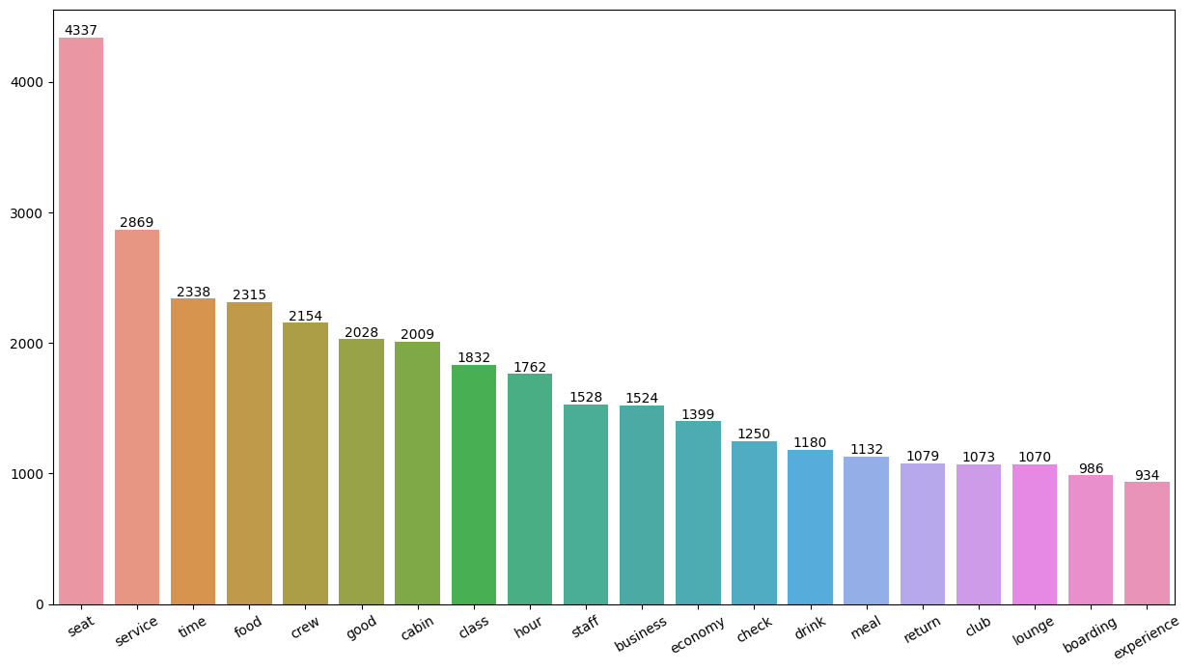

Customers appreciated the cabin crew service, staff, and general economy seats. Many customers also traveled in Business class.
Areas of focus should be on improving economy class service, seats, and enhancing the inflight entertainment experience. It is also important to address delays. In the business class, customers expect a value-for-money experience. Furthermore, customer service should be improved when handling refund requests and streamlining the process.

Slide 4
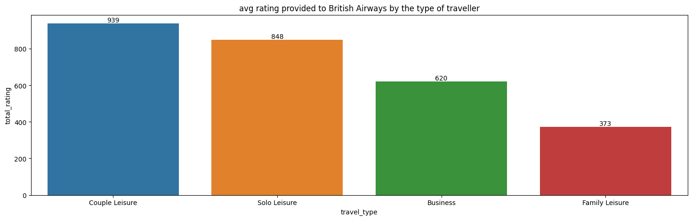
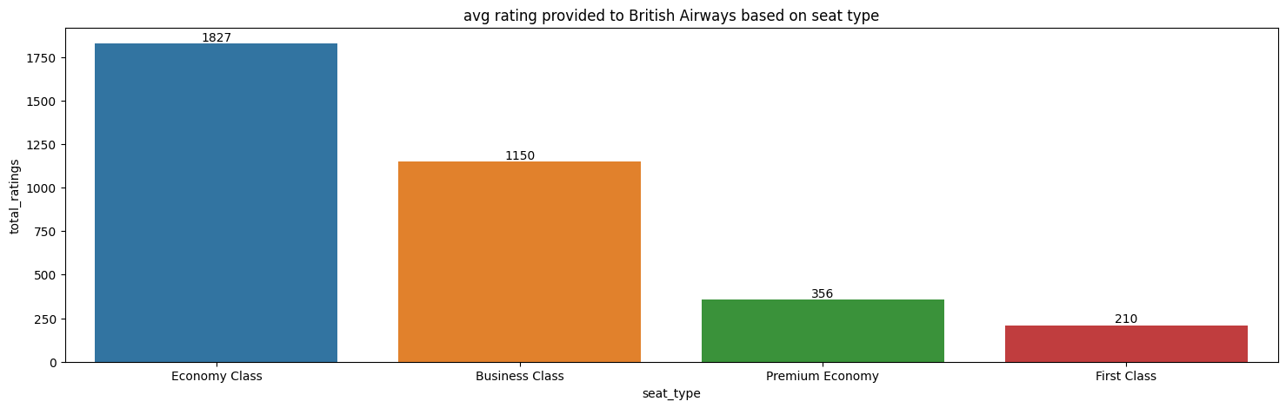
Travellers type couple leisure
Gave most review and those for family leisure tend to review less
Travellers who flew economy class gave the most review.

